Slide 1
Measuring Malaria in Complex Transmission Systems
A Time-at-Risk Based Approach
Alec Georgoff
MMC Meeting, Bangkok, Thailand
November 30, 2018

Slide 2
Introduction

Slide 3
Objectives

Slide 4
Objectives
Mathematical
Underpinnings
The basics of mosquito math
Vector-Based
Approach
Simple
Example
Expanded
Example
R
Implementation

Slide 5
Mathematical Underpinnings

Slide 6
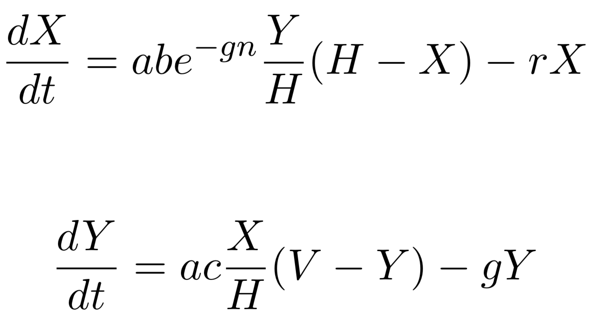
Ross-Macdonald Equations
Infected Humans
Infected Mosquitoes

Slide 7
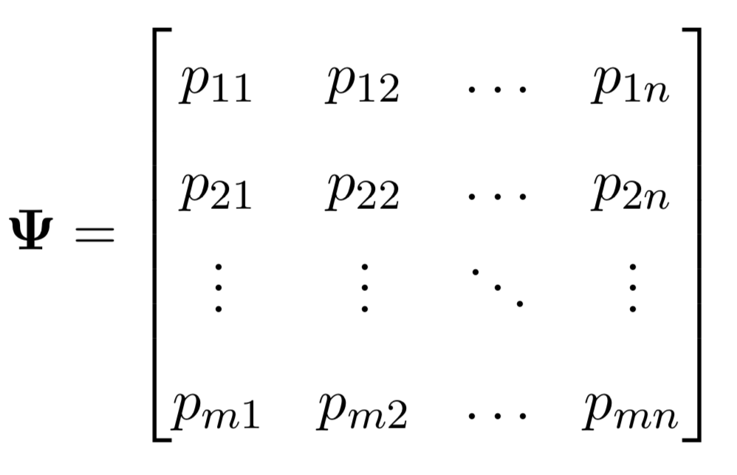
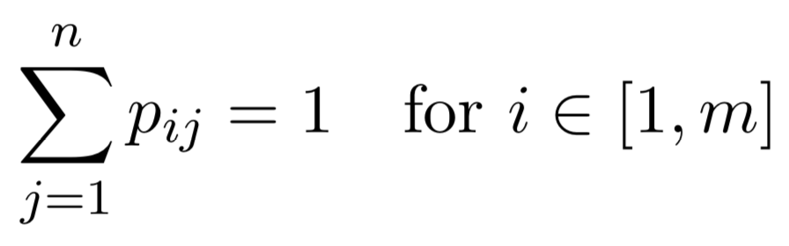
Time-at-Risk (TaR)

Slide 8
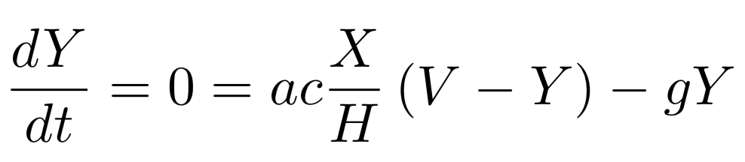
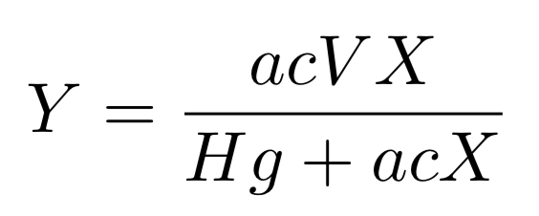
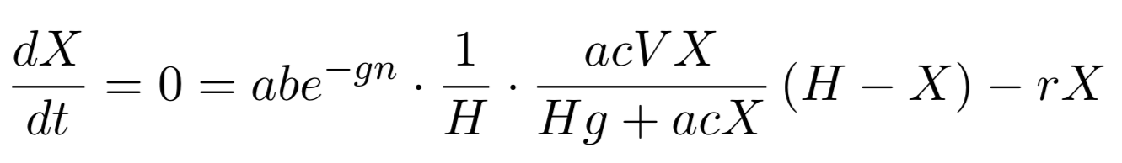
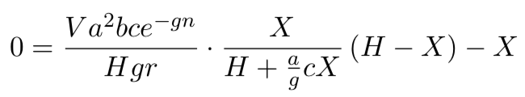
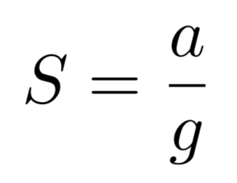
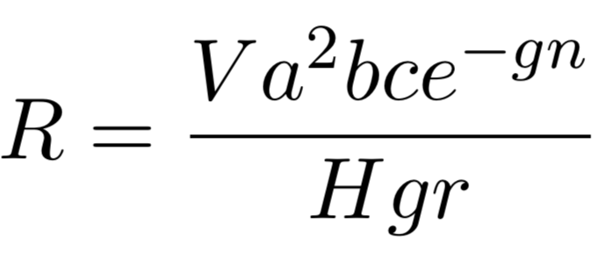
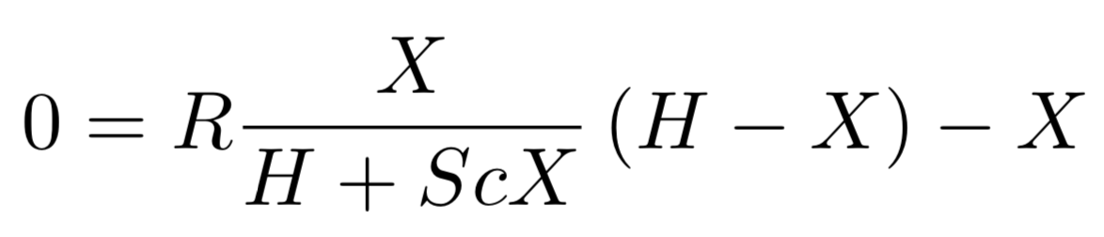
Equilibrium Assumptions

Slide 9
Equilibrium Assumptions

Slide 10
Equilibrium Assumptions

Slide 11
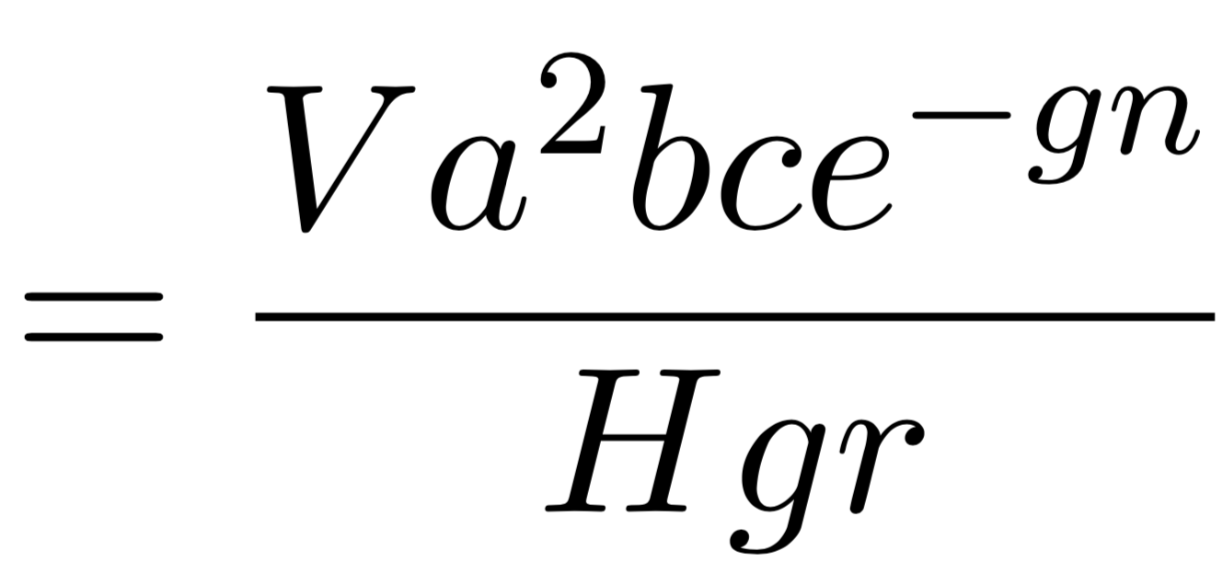
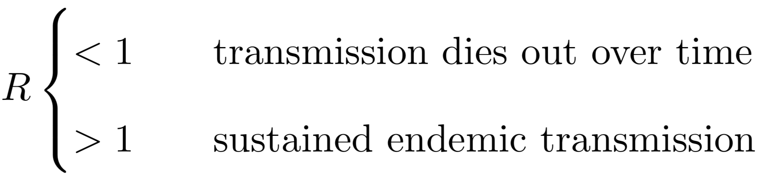
Reproductive Rate

Slide 12
Vector-Based Approach

Slide 13

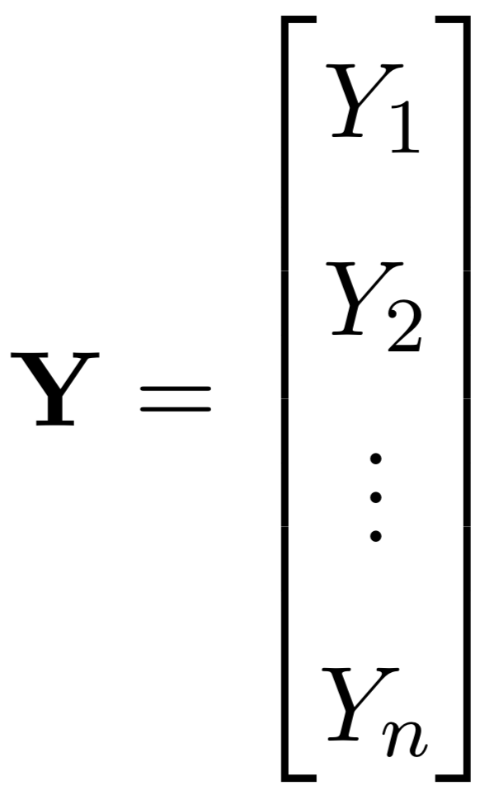
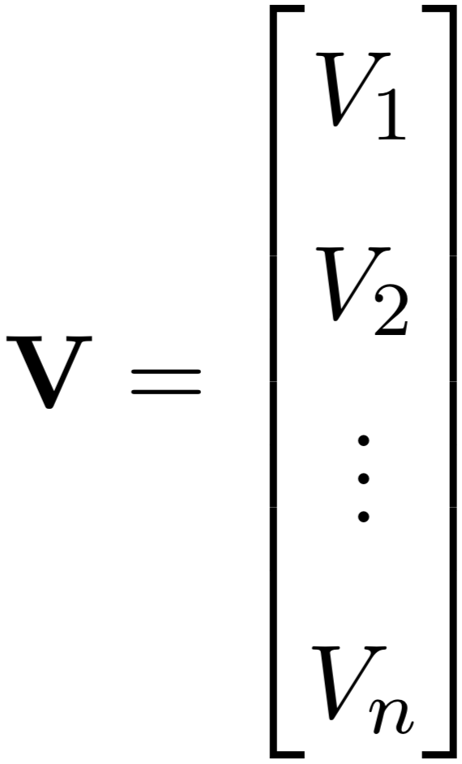
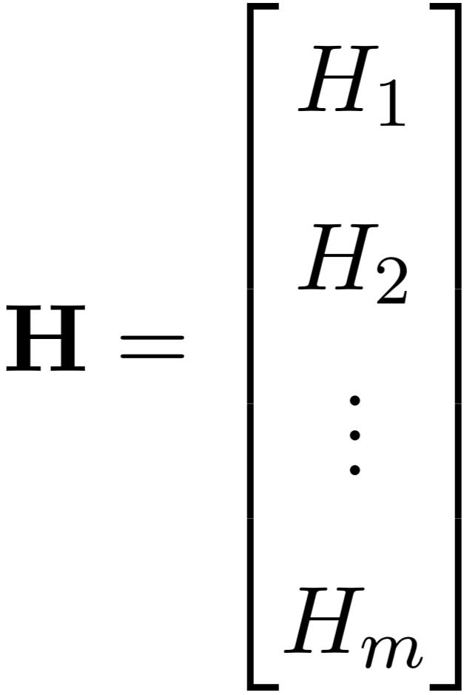
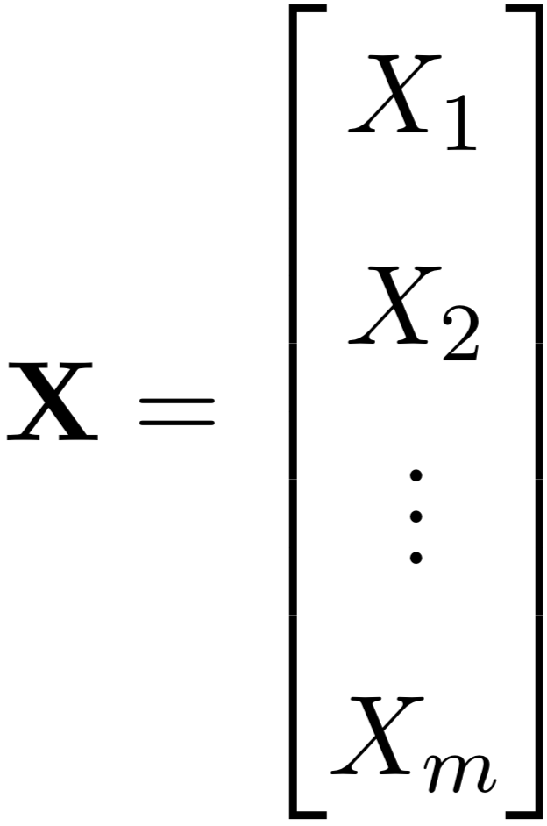
Vectors of Variables

Slide 14


Scaling by Time-at-Risk

Slide 15
Ross-Macdonald Equations

Slide 16
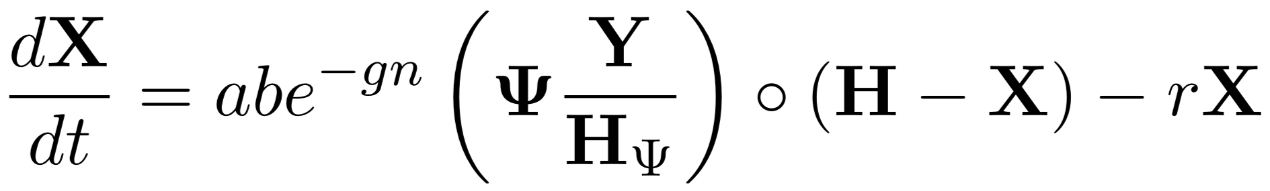
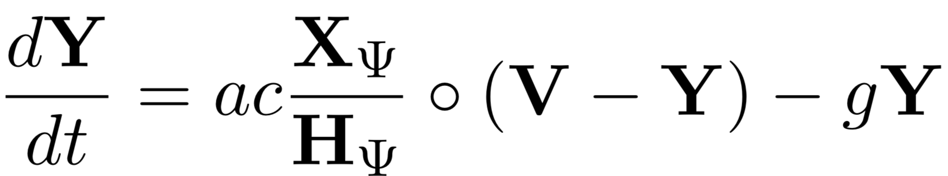
Ross-Macdonald Equations

Slide 17
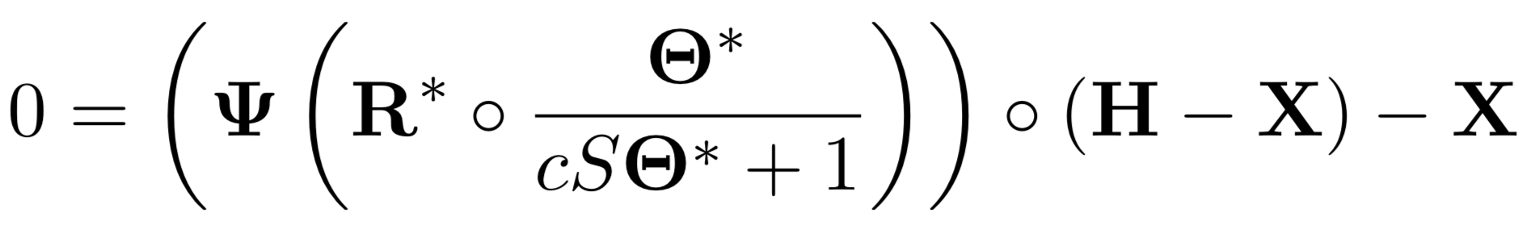
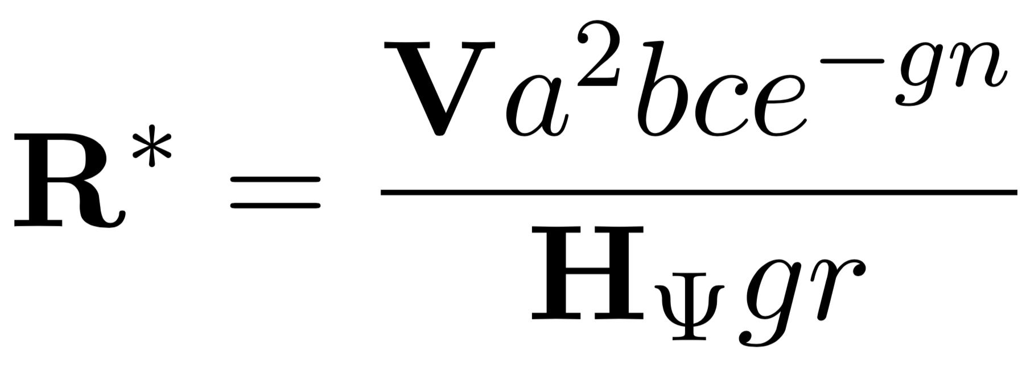
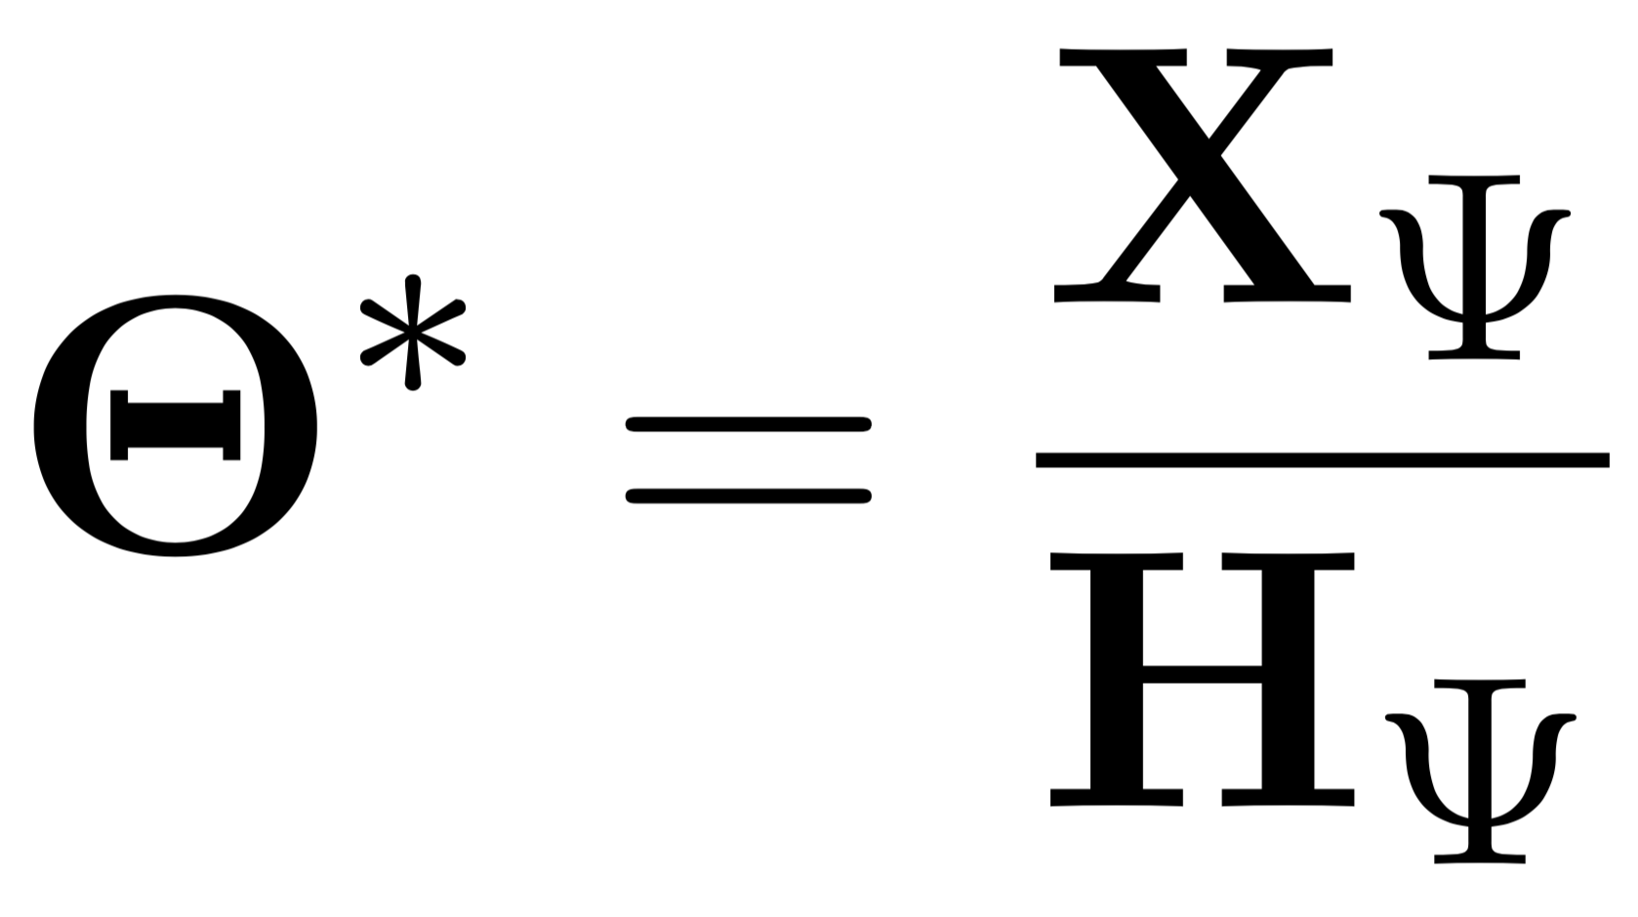
Equilibrium Assumptions

Slide 18
Simple Example

Slide 19
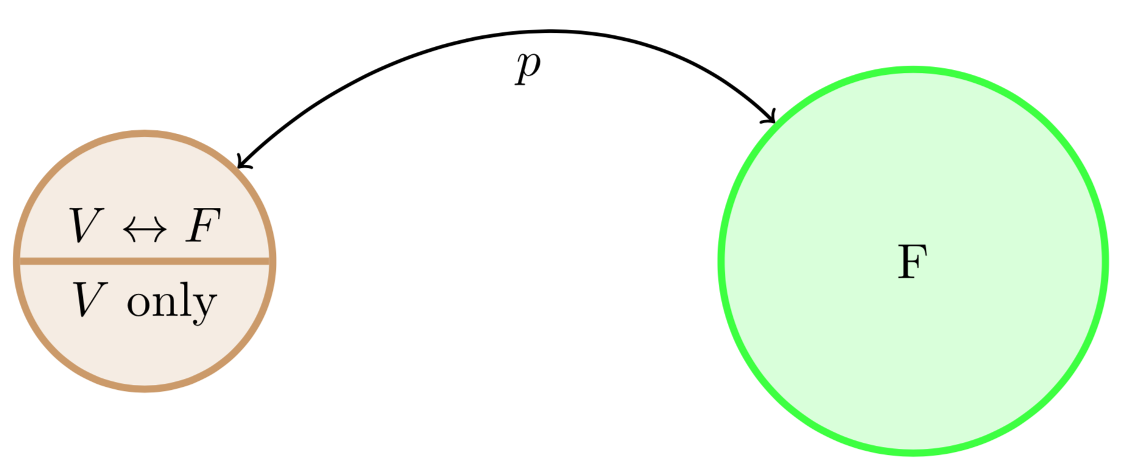
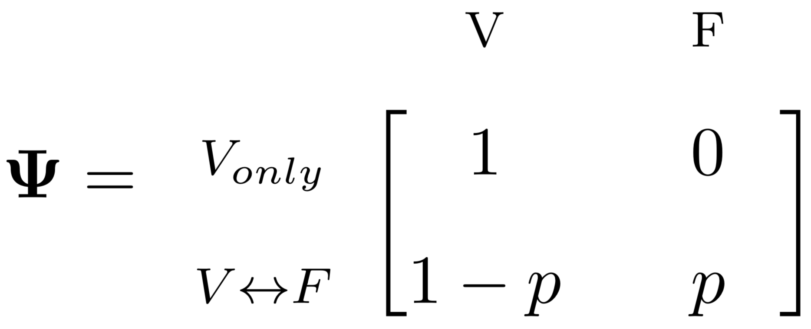
Simple Example: One Village, One Forest

Slide 20
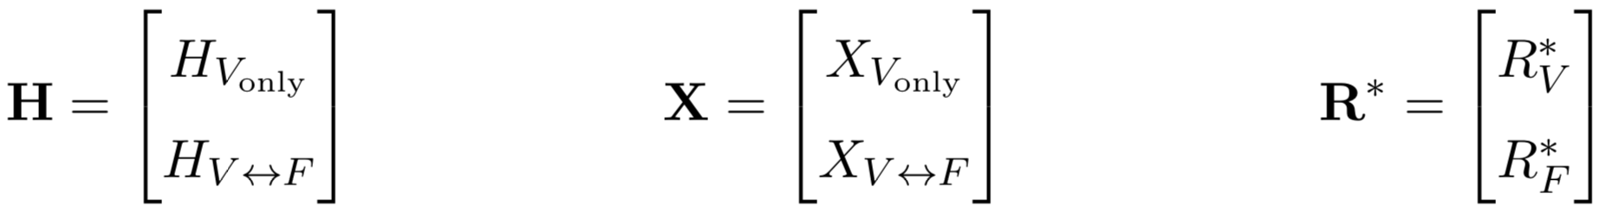
Simple Example: One Village, One Forest

Slide 21
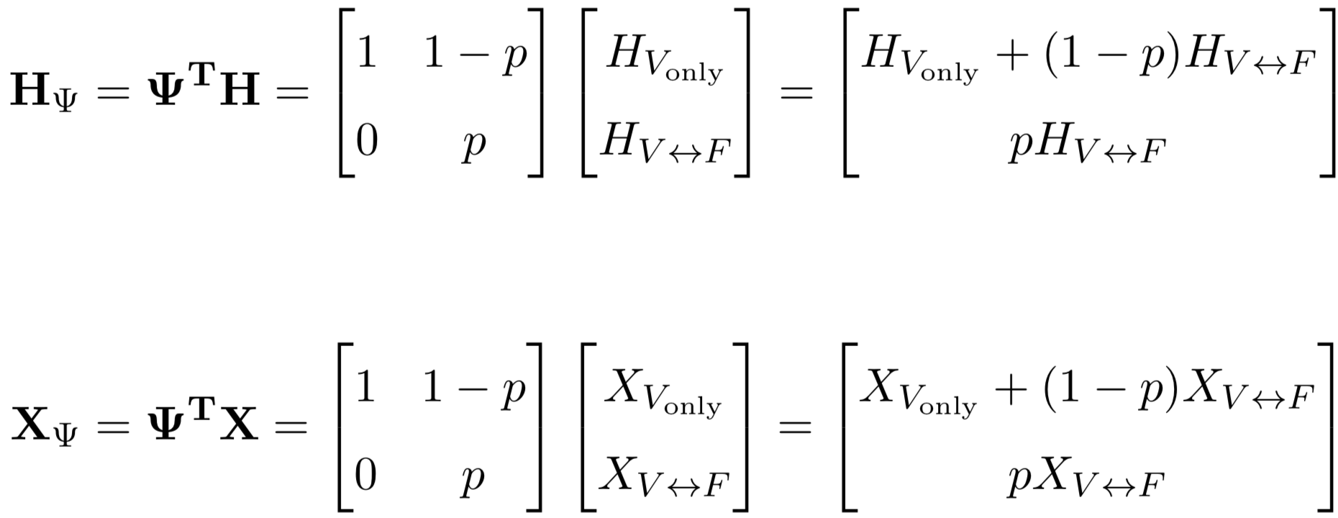
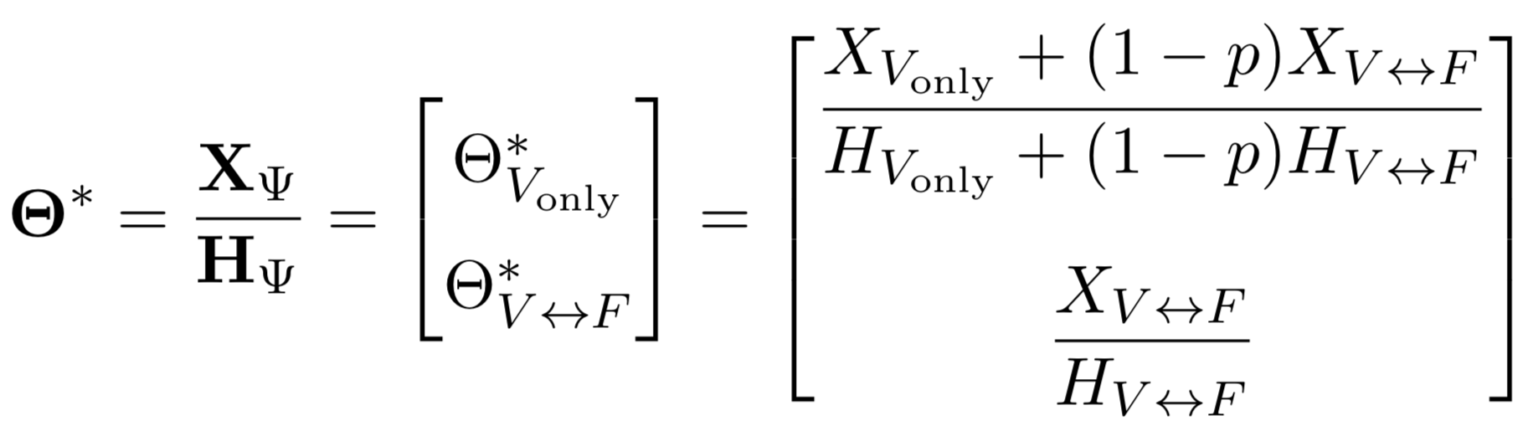
Simple Example: One Village, One Forest

Slide 22

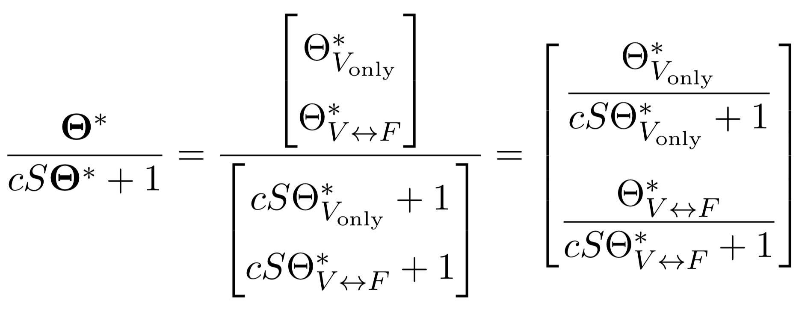
Simple Example: One Village, One Forest
Notes:
delete

Slide 23
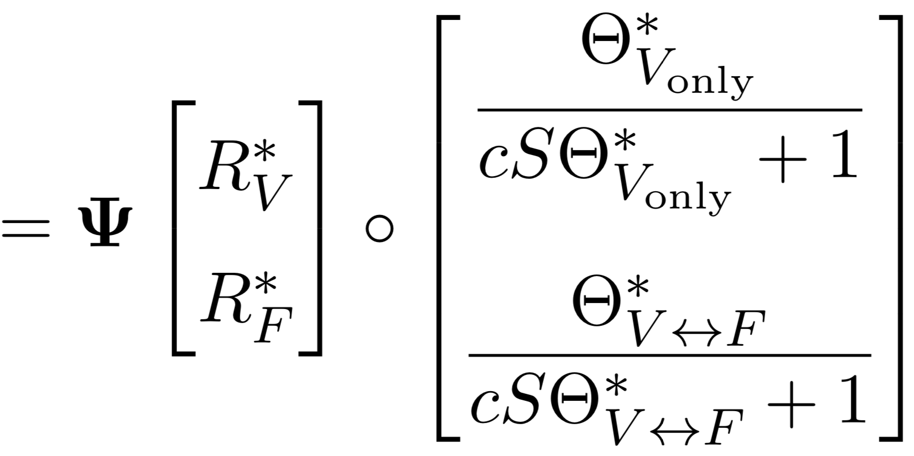
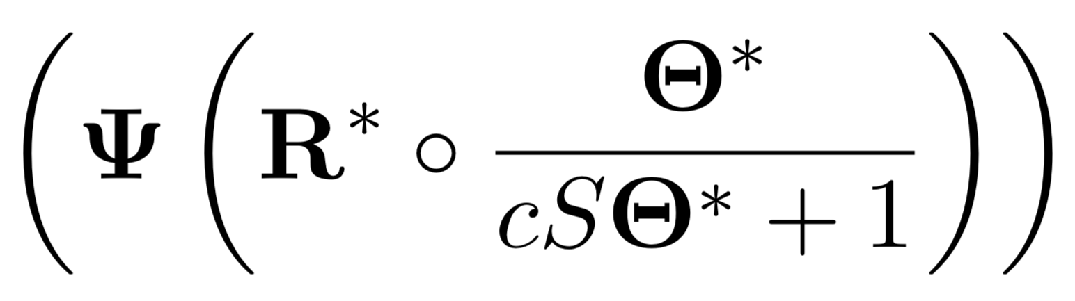
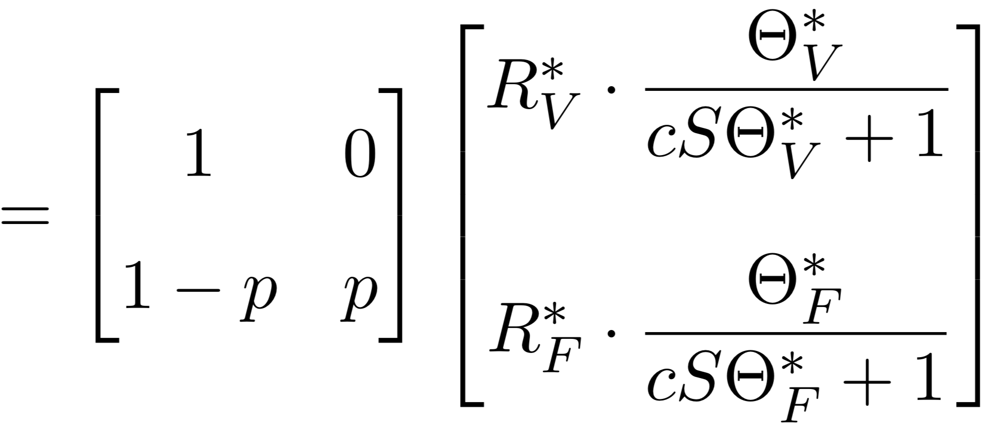
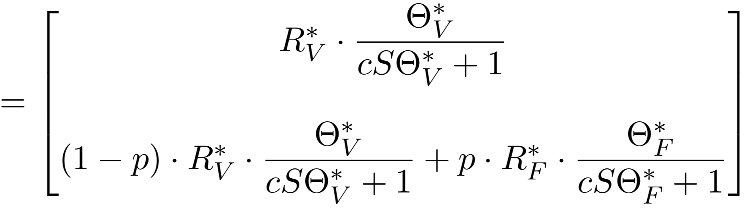
Simple Example: One Village, One Forest
Notes:
delete

Slide 24
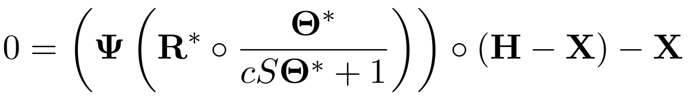
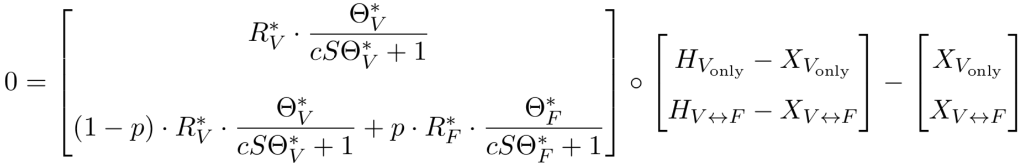
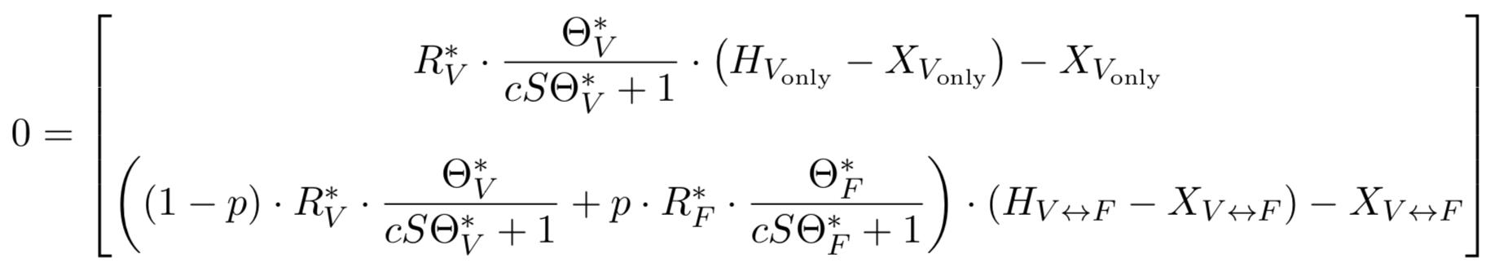
Simple Example: One Village, One Forest

Slide 25
Expanded Example

Slide 26
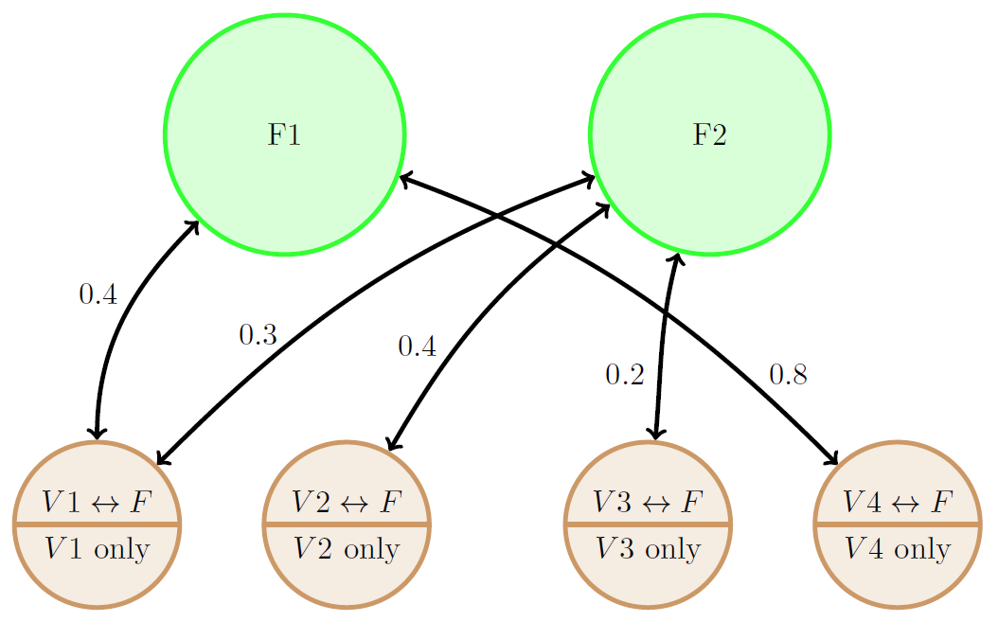
Expand to More Villages and Forests

Slide 27
Expand to More Villages and Forests

Slide 28
Expand to More Villages and Forests

Slide 29
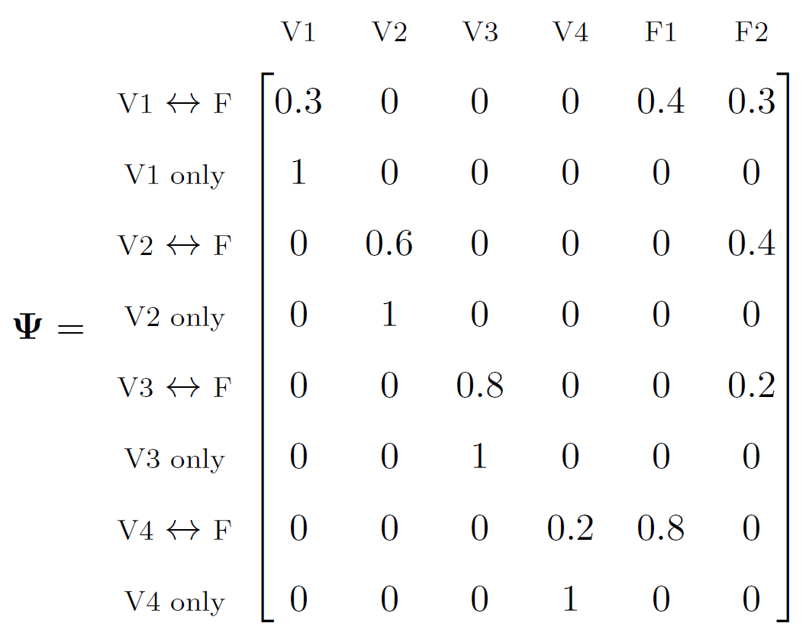
Expand to More Villages and Forests

Slide 30
Implementation In R

Slide 31
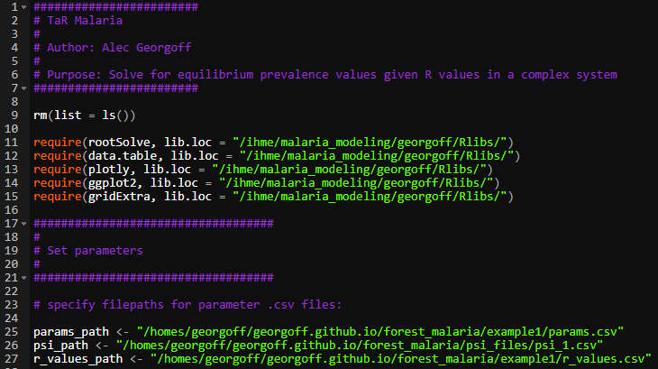
R Code

Slide 32
R Code

Slide 33
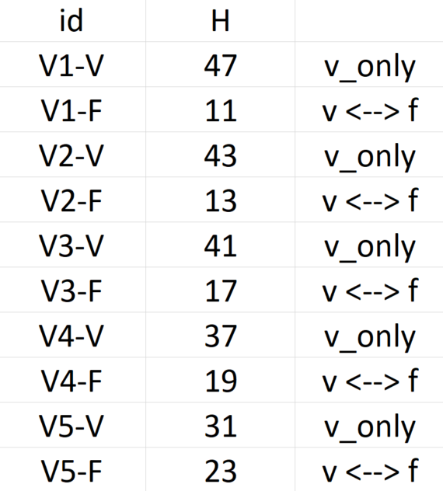
R Code – Parameters

Slide 34
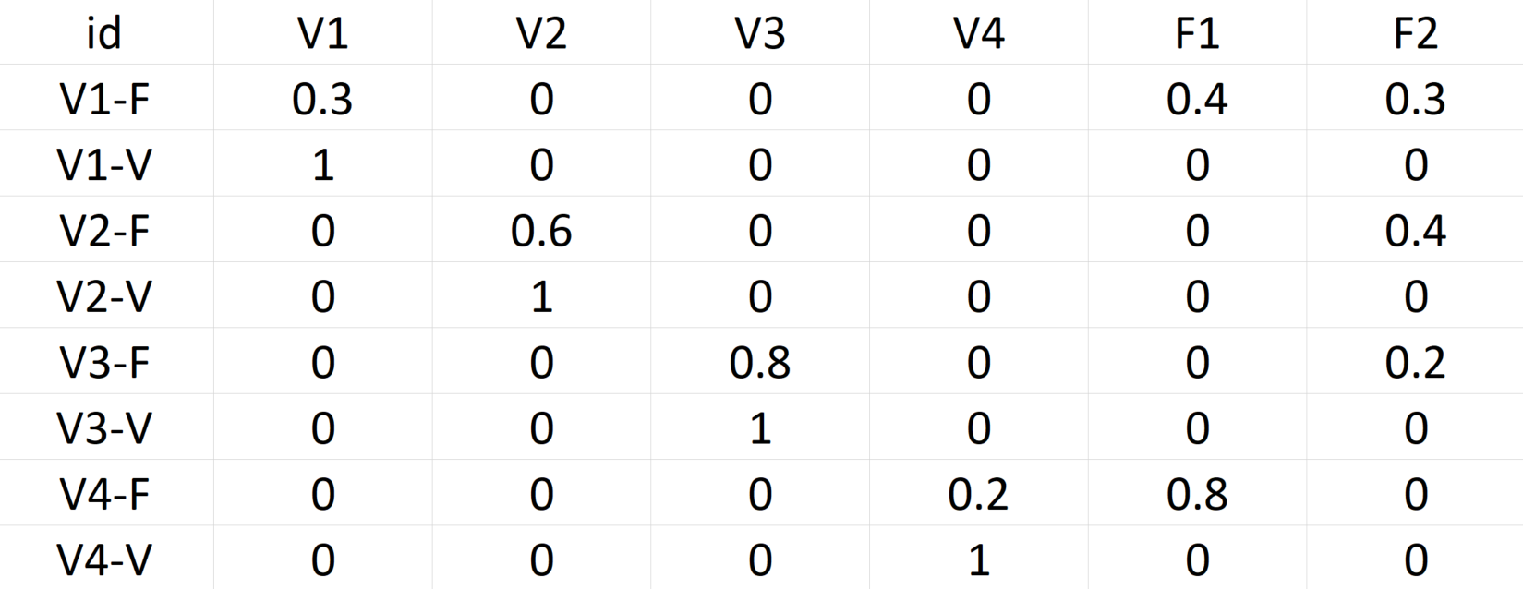
R Code – TaR Matrix

Slide 35
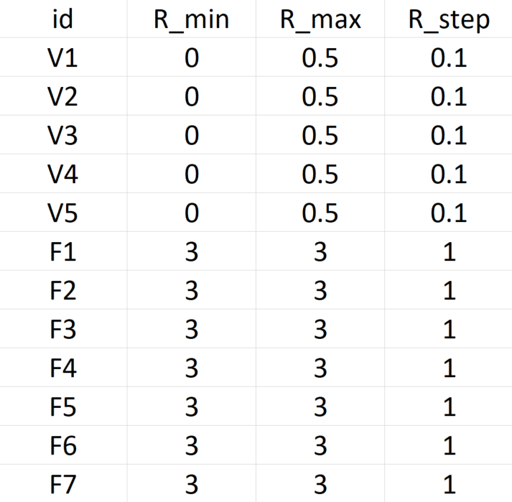
R Code – R Values

Slide 36
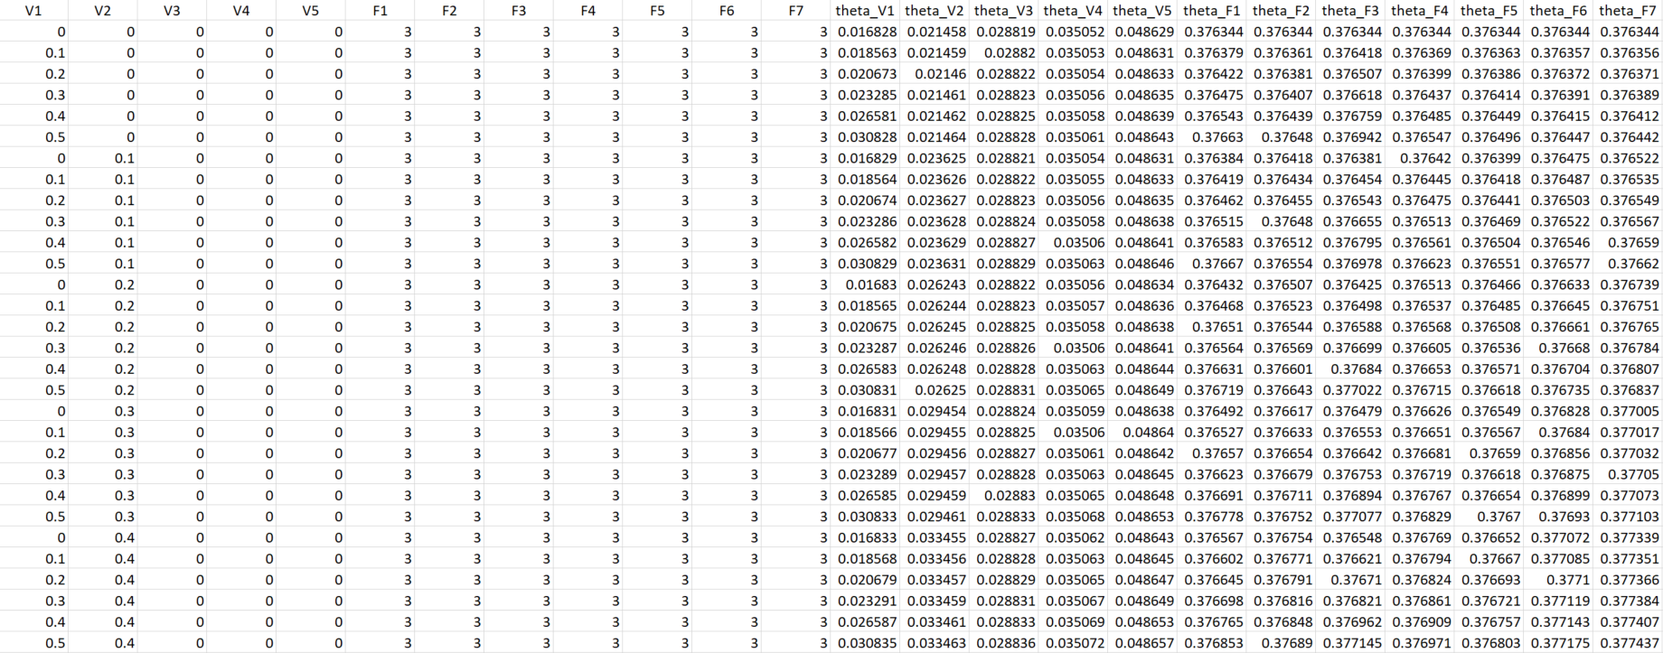
R Code – Results
7776 Rows

